Slide 1
Describing Polymer Molar Mass:
M_{n}, M_{w}, and Ð
Notes:
Intended Learning Outcomes:
-Students will be able to explain why we use multiple methods of describing polymer molecular weight
-Students will be able to define Mn, Mw, and Ð
-Students will be able to calculate Mn, Mw, and Ð from provided data

Slide 2
Why does this matter?
Styrene
104.15 Da
All molecules the same size
Polystyrene
n = 10 to ∞
Different chain lengths within a single sample
T_{g} is dependent upon the polymer’s molar mass because longer chains result in more chain entanglement. These entanglements stiffen the material and increase T_{g}. Polystyrene of 10,000 Da wouldn’t make good plastic cups, but that of 100,000 Da would.
Source: “DSC Measurements of Polystyrene: The Effects of Molecular Weight on Glass Transition” Hitachi High-Tech Science Corporation

Slide 3
Why does this matter?
Melt viscosity and tensile strength also increase with increasing molar mass. The presence of shorter chains can also be beneficial for certain applications.
Macromolecules 1987 DOI: 10.1021/ma00175a030
To learn about how we measure polymer molar mass, check out our MACRO module on SEC, DLS, and MALDI.
J. Am. Chem. Soc. 1945 DOI: 10.1021/ja01227a506

Slide 4
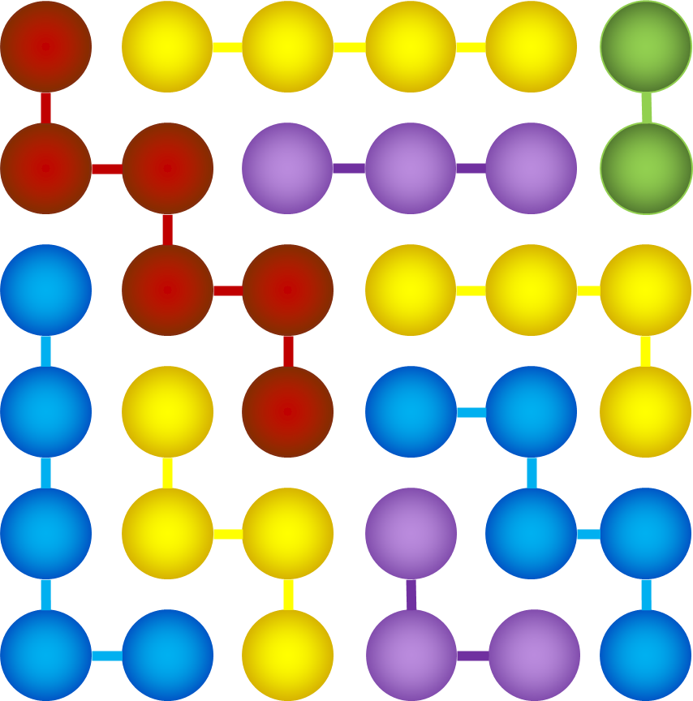
M_{n}, M_{w}, and Ð Illustrated
Each bead is 1 g/mol or 1 Da
Connected beads belong to the same polymer chain
Sample contains:
1 dimer
2 trimers
3 tetramers
2 pentamers
1 hexamer
$$1+2+3+2+1=9 polymer chains in sample$$
$$1\left(2\right)+2\left(3\right)+3\left(4\right)+2\left(5\right)+1\left(6\right)=36 Da of sample$$
Let’s calculate the number-average (M_{n}) and weight-average (M_{w}) molar masses for this hypothetical sample, followed by the dispersity, Ð.

Slide 5
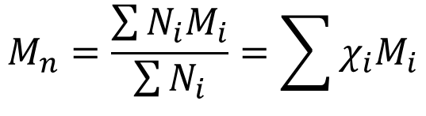
Defining M_{n}
M_{n} is the number-average molecular weight. It is biased towards the molecular weight (M_{x}) shared by the largest number of chains (N_{x}).
M_{n}
N_{x}
$$M_{n}=\frac{\sum{N_{i}M_{i}}}{\sum{N_{i}}}=\sum{χ_{i}M_{i}}$$
M_{x}
Obtained by:
Size Exclusion Chromatography
MALDI Mass spectrometry
Colligative property measurements
End-group analysis
Uses of M_{n}:
Stoichiometric calculations
Thermodynamic properties

Slide 6
M_{n}, M_{w}, and Ð Illustrated
Each bead is 1 g/mol or 1 Da
Connected beads belong to the same polymer chain
Sample contains:
1 dimer
2 trimers
3 tetramers
2 pentamers
1 hexamer
$$1+2+3+2+1=9 polymer chains in sample$$
$$1\left(2\right)+2\left(3\right)+3\left(4\right)+2\left(5\right)+1\left(6\right)=36 Da of sample$$
$$M_{n}=\left(\frac{1}{9}\right)\left(2\right)+\left(\frac{2}{9}\right)\left(3\right)+\left(\frac{3}{9}\right)\left(4\right)+\left(\frac{2}{9}\right)\left(5\right)+\left(\frac{1}{9}\right)\left(6\right)=4.000 Da$$
M_{n} is weighted to the most prevalent chain length in the sample. The tetramers take up 12 of the 36 spaces.
Notes:
The intermediate step in the algebra should read 0.222 + 0.667 + 1.333 + 1.111 + 0.667

Slide 7
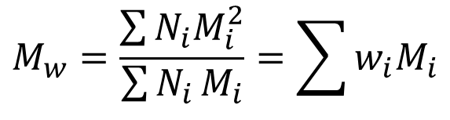
Defining M_{w}
M_{w} is the weight-average molecular weight. It is biased towards the molecular weight (M_{x}) of the heaviest chains (N_{x}).
M_{n}
N_{x}
M_{w}
$$M_{w}=\frac{\sum{N_{i}M_{i}^{2}}}{\sum{N_{i}}M_{i}}=\sum{w_{i}M_{i}}$$
M_{x}
Obtained by:
Size Exclusion Chromatography
MALDI Mass spectrometry
Dynamic Light Scattering
Uses of M_{w}:
Determining materials properties (Young’s modulus, tensile strength, etc.)

Slide 8
M_{n}, M_{w}, and Ð Illustrated
Each bead is 1 g/mol or 1 Da
Connected beads belong to the same polymer chain
Sample contains:
1 dimer
2 trimers
3 tetramers
2 pentamers
1 hexamer
$$1+2+3+2+1=9 polymer chains in sample$$
$$1\left(2\right)+2\left(3\right)+3\left(4\right)+2\left(5\right)+1\left(6\right)=36 Da of sample$$
$$M_{w}=\left(\frac{2}{36}\right)\left(2\right)+\left(\frac{6}{36}\right)\left(3\right)+\left(\frac{12}{36}\right)\left(4\right)+\left(\frac{10}{36}\right)\left(5\right)+\left(\frac{6}{36}\right)\left(6\right)=4.333 Da$$
M_{w} is weighted to the longest chains in the sample. These chains take up 16 of the spaces, while the dimer and trimers only take up 8.
Notes:
The intermediate algebra step should read: 0.111 + 0.500 + 1.333 + 1.389 + 1.000

Slide 9
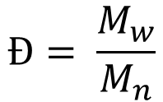
Defining Ð
Ð is the dispersity. It provides a measure of the breadth of the molecular weight distribution. Ð values close to 1 indicate a narrow distribution.
M_{n}
N_{x}
M_{w}
Ð is drawn from measurements of M_{n} and M_{w}.
$$Ð= \frac{M_{w}}{M_{n}}$$
M_{x}
Type of Polymerization | Typical Ð | Example Materials or Methods
Step-Growth | 2 | Condensation polymerizations
Chain-Growth | 1.3-1.6 | Vinyl polymers, Free radical polymerization
Living | <1.2 | Anionic polymerization, Reversible activation-deactivation polymerization

Slide 10

M_{n}, M_{w}, and Ð Illustrated
Each bead is 1 g/mol or 1 Da
Connected beads belong to the same polymer chain
Sample contains:
1 dimer
2 trimers
3 tetramers
2 pentamers
1 hexamer
$$1+2+3+2+1=9 polymer chains in sample$$
$$1\left(2\right)+2\left(3\right)+3\left(4\right)+2\left(5\right)+1\left(6\right)=36 Da of sample$$
This is a fairly narrow Ð, meaning M_{n} and M_{w} are similar.
Based on the previous slide, what type of mechanism
Is most likely to have made this sample?
$$Ð=\frac{4.333}{4.000}=1.083$$

