Slide 1
Polymers: Essential Background and Definitions

Slide 2
Contents
Introduction to polymers (slides 3-6)
Molecular weights and dispersity (slides 7, 8)
Polymer properties (slides 9-11)
Topology (slide 12)
Examples of uses/everyday polymers (13-17)

Slide 3
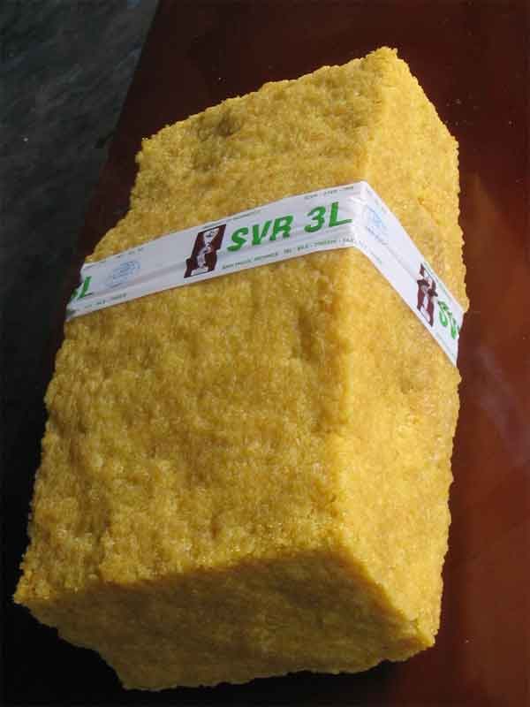
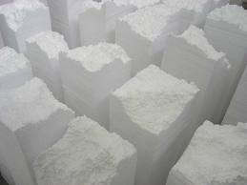
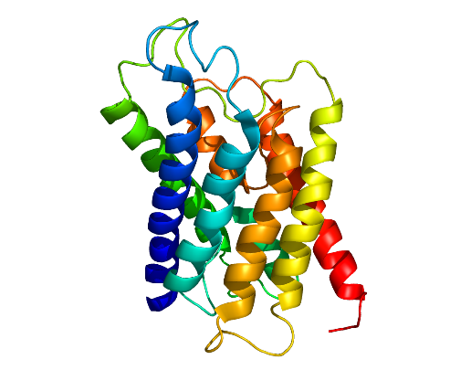
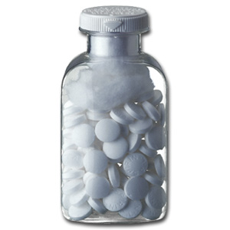
Polymers Compared to Small Molecules
Rubber
Styrofoam
Polypeptide
Aspirin
Notes:
Polymers are depicted as a repeat unit. Shown for comparison is acetyl salicylic acid (aspirin), where the entire molecule is explicitly drawn and all molecules have the exact molecular weight.

Slide 4
The Repeat Unit
backbone
Pendant group
Segment of poly(vinyl chloride)
Polymers may have hundreds to thousands of repeat units, making drawing the entire molecule an impossibility.
Polymer chemists take advantage of the repetitive structure, or repeat unit, and draw this:
Repeat unit of poly(vinyl chloride)
Note: End groups are usually omitted, and “n” is often used to show the non-uniformity of chain lengths

Slide 5
Major Classes of Polymers
Vinyl polymers are commonly
used plastics. High molecular
weights are needed to achieve useful
commercial properties
Condensation polymers are commonly
used as fibers, for example in clothing.
Functional groups in the backbone make
these polymers more rigid and useful
at lower molecular weights.

Slide 6
Polymers are large and slow
Small Molecule Behavior Box
0-500 g/mol
Diffuse easily
Fast mobility
Polymerization
Small
monomer
Large polymer
10,000+ g/mol
Under ambient conditions:
Ethylene gas
Polymers are large, heavy molecules, meaning they:
Move slower than small molecules
Dissolve more slowly in solvents
Tend to be thicker liquids or harder solids
Possess “memory” of previous shapes
Styrene liquid
Polyethylene solid
Polystyrene solid
Notes:
The simplest difference between small molecules and macromolecules is their size, as implied by the terminology. Small molecules are generally no heavier then a few hundred grams per mole, which makes them nimble. Gas molecules bounce around inside their containers and diffuse readily. Liquid molecules engage in vibrant, diffusive, Brownian motion, allowing them to flow even in a condensed phase. Some small molecules possess chemical features that let us use them as monomers. Through polymerization, we convert these individual small monomers into long polymer chains.
In general, a molecular weight of about 10,000 g/mol must be reached for the product to properly behave like a polymer. For reference, you would need to string together about 100 styrene molecules to make a polystyrene chain this heavy. Because the repeat units are now bound to many others in the polymer, the mobility of the structure is greatly reduced. This reduced mobility expresses itself as the polymer having a greater solidity than the monomer, as seen in the lower left representation. The ethylene monomer is a gas, but polyethylene is a dependable solid. Similarly, styrene is a volatile liquid, but polystyrene is a glassy plastic.
This reduced mobility is also responsible for how long it takes polymers to dissolve in a solvent (a week or more!) and how slowly polymers diffuse through a liquid. Finally, the slow polymer chains are similarly slow to respond to deformation, like stretching or compression. They can even get kinetically frozen in a new shape, but still remember a previous one because the chains are so slow to relax and take on new arrangements. If this isn’t handled properly, it can make molded plastic parts break more easily.

Slide 7
Molecular Weight
All molecules of aspirin (acetylsalicylic acid) have a
molar mass of 180.157 g/mol. This is true regardless of
how or where you synthesized the aspirin.
A sample of polystyrene is made up of molecules
with a variety of molecular weights.
Key point: There is no universal “molecular weight” that applies to all molecules of polystyrene or other synthetic polymers.
Notes:
The point of this slide is to differentiate the molecular weight of an organic compound with that of a polymer chain.

Slide 8
Molecular Weight and Dispersity
A sample of polymer chains will have a variety
of molecular weights. The molecular weight of the
sample is expressed as an “average” molecular weight.
The Dispersity of a polymer sample is a measure of the
extent of this variety.
2 main ways to express the average molecular weight (MW):
Number average MW (M_{n}) =
Weight average MW (M_{w}) =
N_{x} = # of molecules having
a mass of M_{x}
So, the sample of polymer chains above would have an M_{n} of 880 g/mol and an M_{w} of 941 g/mol .
The ratio of these two describes the dispersity of the sample: 1.07 (M_{w} / M_{n})
Notes:
This slide gives the details that were introduced in the previous slide.

Slide 9
The Glass Transition (T_{g})
Small Molecule Behavior Box
T_{g} applies to the amorphous portion of the solid polymer.
Polymer (s, glass) ↔ Polymer (s, rubber)
Each polymer has its own T_{g}, just like each small molecule has its own T_{m}.
Ordered crystalline solid melts and freezes
H₂O (s) ↔ H₂O (l)
Polymer | T_{g} (°C)
Rayon™ | 157
Polystyrene | 100
PET soda bottle | 69
Teflon™ | -113
Silicone rubber | -123
Plastic trash bag | -125
At
25 °C:
Above T_{g}: Polymer is soft and rubbery
glassy
Temperature
T_{g}
Below T_{g}: Polymer is hard,
brittle, and glassy
rubbery
Notes:
Conventional small molecules have only one type of solid phase available to them: a well-ordered crystal. However, we saw in the previous slide that polymers are only semicrystalline, at best. The rest of the solid material in a chunk of plastic is “amorphous”. While it is frozen in the solid state (no chains are moving), it doesn’t have any overall order. This is similar to window glass.
Because polymers have two possible solid states, they also have two different solid-phase thermal transitions. Polymer crystallites and small molecules both have melting temperatures, the temperature at which the solid crystal becomes a liquid. The glass transition, however, is unique to polymers, and applies to the amorphous portion of the solid. Below the Tg, the chains are kinetically frozen in place, resulting in brittle, glassy material properties. If the polymer is heated above the Tg, the chains unfreeze and become more mobile. They do not actually melt, but they become flexible rather than frozen. In this state, the polymer shows rubber-like properties like decreased stiffness, stretchability, and bounciness.
Just like each small molecule substance has its own Tm, each type of polymer has its own Tg. The Tg is strongly affected by the structure of the polymer. Things that can increase Tg, and therefore make a polymer glassier, include stiff structures in the backbone like aromatic rings and strong interactions between chains like hydrogen bonding.

Slide 10
Polymers are viscoelastic
Small Molecule Behavior Box
Polymers are large and therefore slow, so depending on time scale and temperature they may behave -
more like a solid or more like a liquid.
Visco-elastic
Under shear (sliding force), a solid stretches like a spring, and a liquid flows. All matter is either solid or liquid, never both.
“liquid-like”
“solid-like”
Fast Deformation or Low Temperature | Slow Deformation or High Temperature
Reduced chain mobility Fast deformation doesn’t give chains time to relax and flow Low temperatures freeze chains in place Polymer acts more “solid-like” | Increased chain mobility Slow deformation allows chains time to relax and flow High temperatures soften chains, letting them move Polymer acts more “liquid-like”
Notes:
Much of what we love about polymers as a material derives from the fact that they simultaneously display solid-like and liquid-like responses to mechanical stress. Ideal liquids and solids consist of a surprisingly tiny portion of the materials we handle every day. Ideal fluids always have the same viscosity, or thickness, no matter how fast you force them to flow. Ideal solids behave like perfect rubber bands; after being stretched or compressed, they return exactly to their previous shape. A classic example of an ideal fluid is air, while the classic ideal solid is a crystal.
Polymers blur the line between these two paradigms, behavior more liquid-like or more solid-like depending on exactly how the deformation is taking place. A ball of silly putty is an excellent visual aid or hands-on manipulative for students to grasp this concept. Silly putty is made of poly(dimethyl siloxane), a common polymer. Because polymer chains have reduced mobility, time-scale is one of the factors that controls the material response. If the polymer is deformed quickly (for example, bouncing silly putty on the table), the chains have no time to react and flow, and therefore the material behaves more like a solid. On the other hand, if you deform the polymer slowly (for example, slowly stretching a silly putty rope), the chains have time to relax and reorganize themselves in response, permitting the material to flow in a more liquid-like manner.

Slide 11
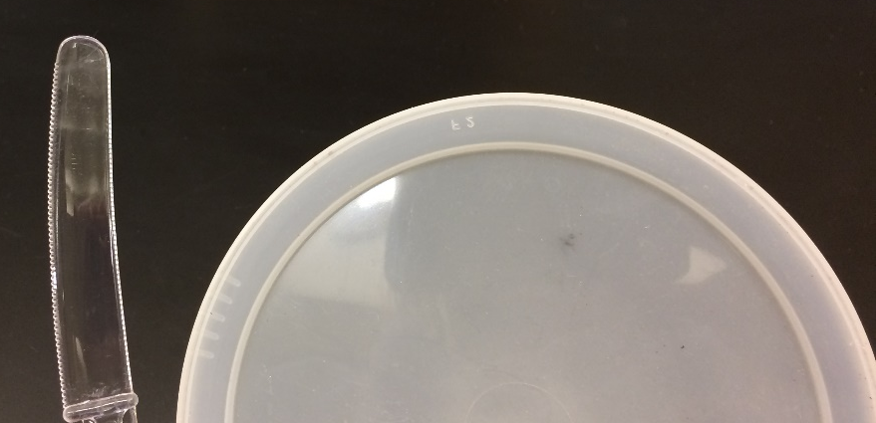
Polymers may be semicrystalline
Small Molecule Behavior Box
Polymers only partially crystallize in the solid state, resulting in polymer crystallites surrounded by amorphous solid polymer. Some polymers are entirely amorphous and do not crystallize.
Well-ordered,
crystalline,
solid
Ordered polymer crystallites
Polymer crystals scatter light, making crystalline polymers appear opaque (right) and amorphous polymers appear transparent (left).
Disordered amorphous polymer
Notes:
Another key feature of polymers is that they are not entirely crystalline in the solid state. Instead, polymers may be semicrystalline. Small crystallites of ordered polymer are in a sea of disordered, but still solid, polymer. This disordered material is referred to as “amorphous”. The proportion of crystalline to amorphous material depends on the identity of the polymer and exactly how that polymer was processed (for example, how quickly it was cooled from the melt or whether a nucleating agent was added to encourage crystallite growth). Polymers with simple, highly regular structures generally have higher % crystallinity. Branching, long side chains, and low molecular weight all suppress crystallinity. Some polymers are even fully amorphous in the solid state.
The crystallites have melting transitions, just like small molecule crystals, and each polymer has its own particular Tm for the crystalline portion. The amorphous portion has its own thermal transition, the glass transition, which is discussed on the next slide.
Crystallinity has two major effects. More crystalline content provides mechanical reinforcement, resulting in harder, stiffer polymers. Crystallites also scatter light, which results in more crystalline polymers appearing visually opaque. Fully amorphous polymers are visually transparent.

Slide 12
Topology of Polymers
The properties of synthetic polymers depend not only on their chemical composition, but also on their 3D architecture, or topology.
An area of intense interest in synthetic polymer chemistry is devising routes to precisely control the topology of the polymers being created.
Examples of polymer topologies are:
Linear
Cyclic
Network
(Gel)
Dendrimer
Star
Branched polymer
Graft copolymer
(comb or brush polymer)

Slide 13
Familiar Polymers in Everyday Life
Poly(ethylene) (PE)
Poly(vinyl chloride (PVC)
Poly(tetrafluoroethylene)
”Teflon”
Simple changes to the backbone result in major changes in the properties
PE : plastic grocery bags
PVC : pipes to chewing gum (plasticizer)
Teflon : non-stick coating
Notes:
(? How do you stick it to the pan)

Slide 14
Polymers is Personal Care
Poly(ethylene oxide) (PEO)
Poly(ethylene glycol) (PEG)
Review shampoo bottles
  PVA###
  PEG###
Poly(vinyl alcohol) (PVA)

Slide 15
Polymers in Clothing
Poly(ester)
Poly(amide)
Vary the R group to control properties
Rayon
Nylon
Notes:
These are often step or condensation polymers.

Slide 16
Multi-purpose
Poly(methyl methacrylate) (PMMA)
Poly(styrene) PS
Windshields (Plexiglass)
Hard contact lens
Cavity fillings
Red “Solo” cups
“Styrofoam”

Slide 17
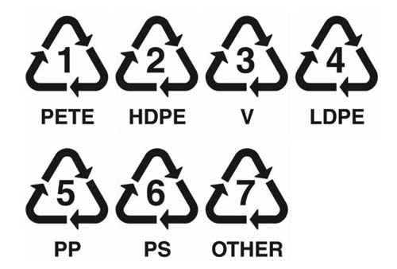
Recycling of Synthetic Polymers
Poly(ethylene terephthalate) (PET)
High Density Poly(Ethylene) (HDPE)
Poly(vinyl chloride) (PVC)
Low Density Poly(Ethylene) (LDPE)
Poly(propylene) (PP)
Poly(styrene) (PS)

